Slide 1
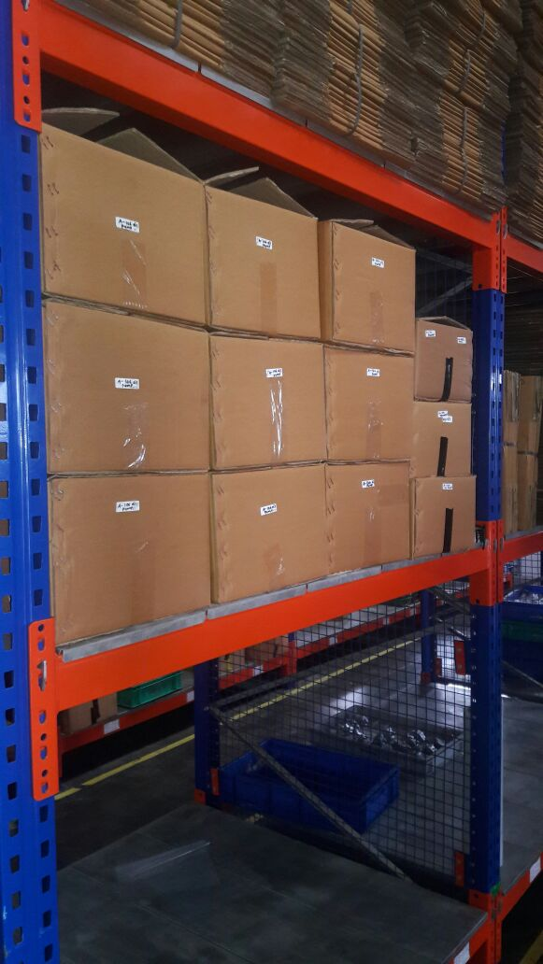
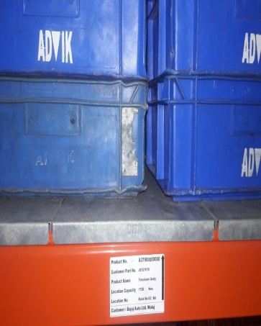
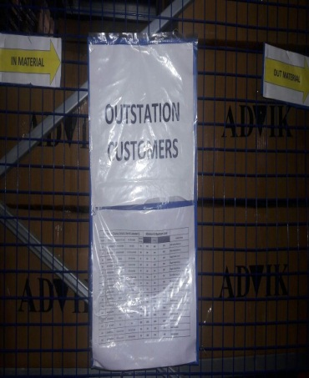
P15
TPM CIRCLE NO :-
ACTIVITY
KK
QM
PM
JH
SHE
OT
DM
E&T
KAIZEN IDEA SHEET
TPM CIRCLE NAME:
LOSS NO. / STEP
DEPT :- Dispatch
RESULT AREA
P
Q
A
C
D
S
M
CELL:- FG AREA
CELL NAME:- FG MATERIAL
MACHINE / STAGE :-
OPERATION :-Stock taking & Reg.dispatch
KAIZEN THEME : To reduce searching time for material founding in FG Area
IDEA :- Customer wise Material Location defined in Rack
Problem present status :-
COUNTERMEASURE:-
BENCHMARK
1
TARGET
KAIZEN START
15.07.2016
TDC
KAIZEN FINISH
23.07.2016
TEAM MEMBERS :
1.Anil Mane 3.Pandurang Kad
2.Sandeep Borkar4.Vinod Padvekar
5.Tushar Kolekar 6.Priya Deshmukh
BENEFITS :-
1.To easily stock taking activity.
2. Minimum and maximum level defined
for material
3.Time Saving
Before
After
WHY - WHY ANALYSIS :-
1.Material not place on proper location
2. 1s’ 2s not maintain at work area
3. Very difficult to taking opening stock.
4. Mix-up material Issue
4.Minimum and maximum level not defined for material
5.Operator have a Fatigue for material founding
6. Time required for material finding
RESULT :-
All Material place on proper location.
1s’2s maintain at work area before shift starting.
Now we are taking easily stock due to proper location
Very easy to find Material with proper location
Minimum and maximum level defined for material
6. Now operator easily find out the material
7. Time Save
KAIZEN SUSTENANCE
WHAT TO DO:- We need to put all material as per location
HOW TO DO:- Material put on location as per List
FREQUENCY :- We monitor on daily basis.
ROOT CAUSE :-
REGISTRATION NO. & DATE :
SCOPE & PLAN FOR HORIZONTAL DEPLOYMENT
REGISTERED BY :-
SR.
NO.
CELL
TARGET
RESPONSIBILITY
STATUS
MANAGER’S SIGN :-
1
Export ,SPD AND After Market packing Material Area

